Slide 1
Introduction
In the previous lesson, we applied the properties of similar triangles to find unknown side lengths. We discovered that the side ratios of similar triangles are always the same. As a preparation to using trigonometry to solve problems, we will look more deeply into the relationship between sine and cosine in this lesson.

Slide 2
Key Concepts
Sine and cosine are side length ratios in right triangles.
The ratio for the sine of an angle is as follows:
The ratio for the cosine of an angle is as follows:

Slide 3
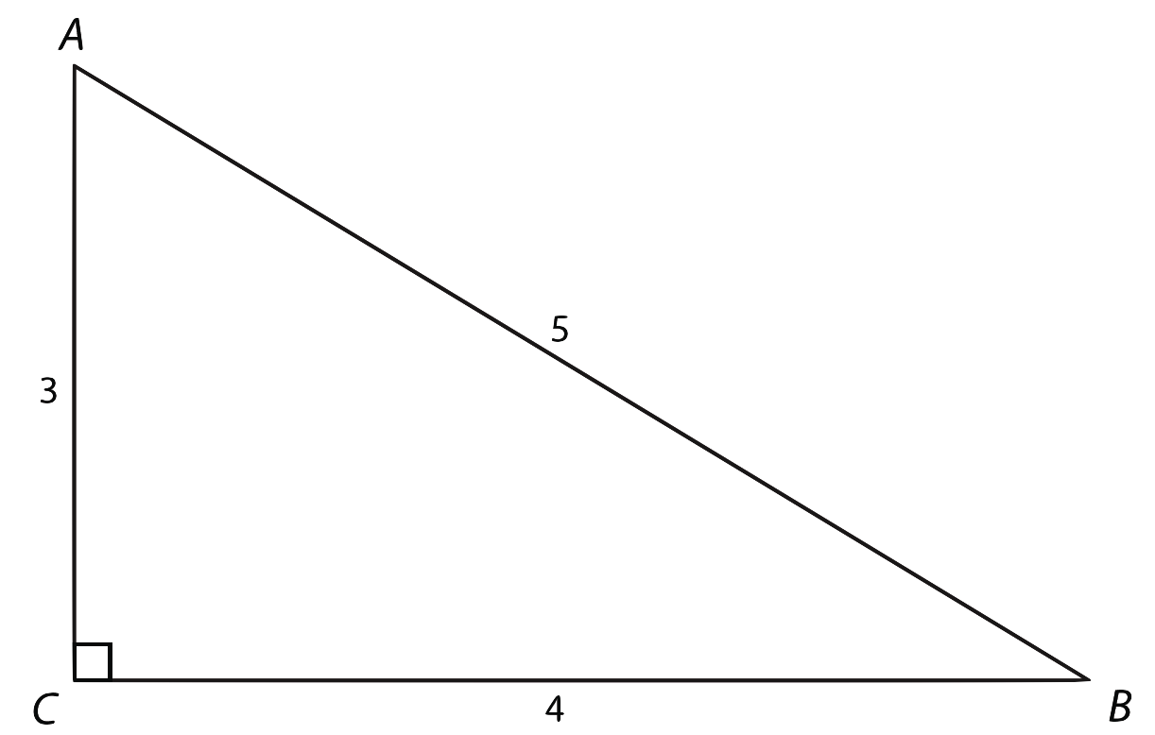
Key Concepts, continued
Examine

Slide 4
Key Concepts, continued
Determine the sine of
Determine the cosine of
This shows sin A = cos B.
You can also see from the diagram that
Show that this relationship will work for any right triangle.

Slide 5
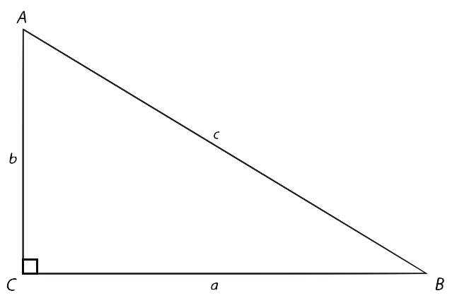
Key Concepts, continued
In , sin A = cos B, and sin B = cos A.

Slide 6
Key Concepts, continued
This relationship between sine and cosine is known as an identity. An equation is an identity if it is true for every value that is used in the equation.
Sine and cosine are called cofunctions because the value of one ratio for one angle is the same as the value of the other ratio for the other angle.
The two acute angles in a right triangle have a sum of 90º. They are complementary angles. If one acute angle has a measure of θ, the other angle has a measure of 90º − θ.

Slide 7
Key Concepts, continued
For example, if one acute angle θ has a measure of 70º, the other acute angle must measure 90º − θ. 90º – θ = 90º – 70º = 20º
The sine-cosine cofunctions can be written as:
In other words, you can use the sine of one acute angle to find the cosine of its complementary angle.
Also, you can use the cosine of one acute angle to find the sine of its complementary angle.

Slide 8
Key Concepts, continued
This identity relationship makes sense because the same side lengths are being used in the ratios for the different angles.
Cofunctions such as sine-cosine give you flexibility in solving problems, particularly if several ratios of trigonometry are used in the same problem.
Postulate
Sine and cosine are cofunction identities.

Slide 9
Common Errors/Misconceptions
losing track of which side length or angle is being solved for
forgetting to take the complement of the angle when using the sine-cosine cofunction

Slide 10
Guided Practice
Example 1
Find

Slide 11
Guided Practice: Example 1, continued
Set up the identity.

Slide 12
Guided Practice: Example 1, continued
Substitute the values of the angles into the identity and simplify.

Slide 13
Guided Practice: Example 1, continued
Verify the identity by calculating the sine of 28° and the cosine of 62° using a scientific calculator.
✔

Slide 14
Guided Practice: Example 1, continued
Notes:
http://www.walch.com/ei/00183

Slide 15
Guided Practice
Example 3
Find a value of φ for which sin φ = cos 15° is true.

Slide 16
Guided Practice: Example 3, continued
Determine which identity to use.
The cosine was given, so use the cosine identity.
Since φ is used as the variable in the problem, use the variable phi ( ) for the identity.
The cosine of 15°is equal to the sine of its complement.

Slide 17
Guided Practice: Example 3, continued
Find the complement of 15 °.
The complement of 15°is 75°.

Slide 18
Guided Practice: Example 3, continued
Substitute the complement of 15° into the identity.

Slide 19
Guided Practice: Example 3, continued
Write the value of φ. φ = 75º
✔

Slide 20
Guided Practice: Example 3, continued
Notes:
http://www.walch.com/ei/00184

